Slide 1

7th Grade Accelerated Math
Unit 3, Lesson 6 Evaluating Numerical Expressions with Integer Exponents Volume 1, pg. 129

Slide 2


Benchmark
MA.8.NSO.1.3
Extend previous understanding of the Laws of Exponents to include integer exponents. Apply the Laws of Exponents to evaluate numerical expressions and generate equivalent numerical expressions, limited to integer exponents and rational number bases, with procedural fluency.
volume 1, pg. 129

Slide 3
Integrated Mathematical Thinking and Reasoning Standards
MA.K12.MTR.1.1 Actively participate in effortful learning both individually and collectively.
MA.K12.MTR.3.1 Complete tasks with mathematical fluency.
MA.K12.MTR.4.1 Engage in discussions that reflect on the mathematical thinking of self and others.
volume 1, pg. 129

Slide 4

Learning Target
I can evaluate a numerical expression using the laws of exponents.
volume 1, pg. 129

Slide 5

Warm-Up
volume 1, pg. 130

Slide 6
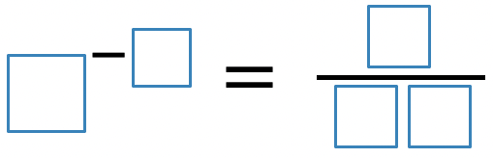
3.6.1 Warm-Up: Negative Exponents
Place a digit in each blue box to make the statement true. Use only digits 0 to 9, at most one time each.
volume 1, pg. 130

Slide 7

Guided Instruction
volume 1, pg. 130

Slide 8
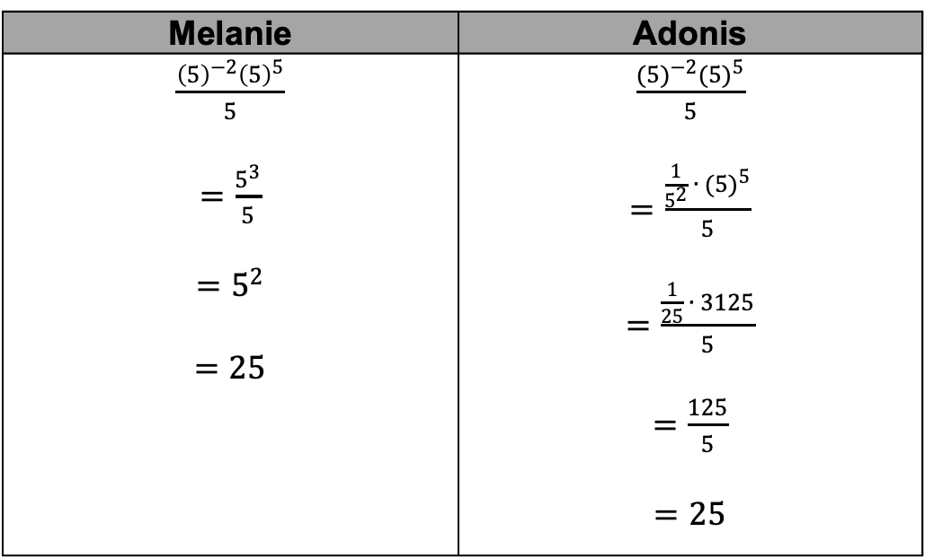
3.6.2 Guided Instruction: Using the Laws of Exponents to Evaluate Expressions
Melanie and Adonis each evaluated the expression $\frac{{(5)}^{−2}{(5)}^{5}}{5}$. Each student’s steps are shown.
Melanie | Adonis
$\frac{{\left(5\right)}^{−2}{\left(5\right)}^{5}}{5}$ $=\frac{5^{3}}{5}$ $$=5^{2}$$ $$=25$$ | $\frac{{(5)}^{−2}{(5)}^{5}}{5}$ $=\frac{\frac{1}{5^{2}} ∙ {(5)}^{5}}{5}$ $=\frac{\frac{1}{25} ∙ 3125}{5}$ $=\frac{125}{5}$ $$=25$$
volume 1, pg. 130

Slide 9
Discuss with your partner how Melanie’s steps and Adonis’ steps are similar and different from each other. Then, summarize your discussion in the table.
Similarities | Differences
volume 1, pg. 130

Slide 10



Complete the steps to evaluate the expression $\frac{{{(6}^{2})}^{−3}}{6^{−5}}$ by completing the description of each step and writing the resulting equivalent expression on the line that follows.
Apply __________
Apply __________
Evaluate. __________
When evaluating exponential expressions, it is helpful to apply the laws of exponents before evaluating.
volume 1, pg. 131

Slide 11
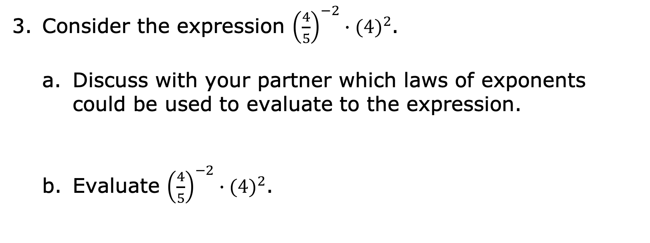
Consider the expression ${\left(\frac{4}{5}\right)}^{−2}∙{(4)}^{2}$.
Discuss with your partner which laws of exponents could be used to evaluate to the expression.
Evaluate ${\left(\frac{4}{5}\right)}^{−2}∙{(4)}^{2}$.
volume 1, pg. 131

Slide 12

Try It
volume 1, pg. 131

Slide 13

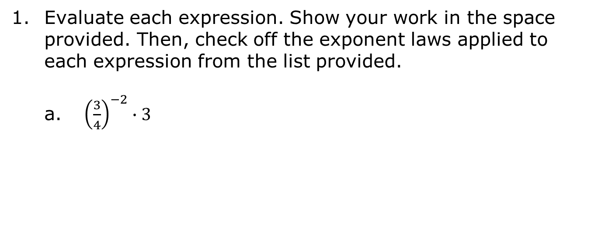
3.6.3 Try It: Evaluating Expressions
Evaluate each expression. Show your work in the space provided. Then, check off the exponent laws applied to each expression from the list provided.
${\left(\frac{3}{4}\right)}^{−2}∙3$
Exponent Laws Applied
identity exponent negative exponent power of a power power of a product power of a quotient product of powers quotient of powers zero exponent
volume 1, pg. 131

Slide 14
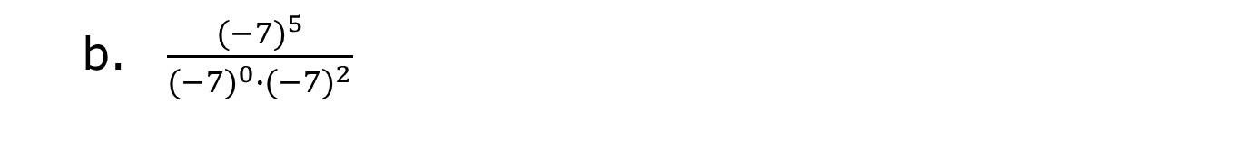
$\frac{{(−7)}^{5}}{{(−7)}^{0}∙{(−7)}^{2}}$
Exponent Laws Applied
identity exponent negative exponent power of a power power of a product power of a quotient product of powers quotient of powers zero exponent
volume 1, pg. 131

Slide 15

Guided Practice
volume 1, pg. 132

Slide 16

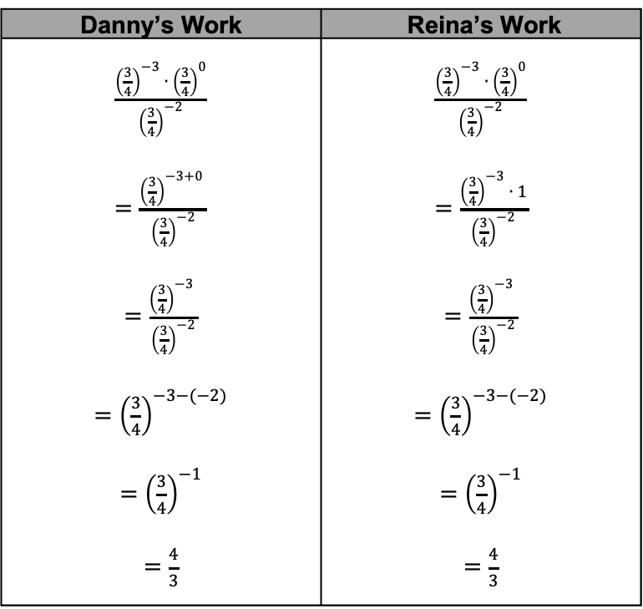
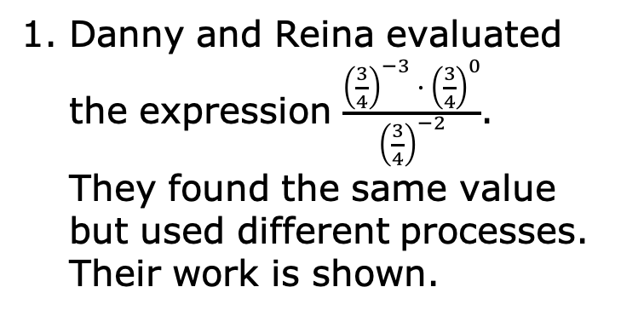
3.6.4 Guided Practice: Evaluating Exponential Expressions
Danny and Reina evaluated the expression $\frac{{\left(\frac{3}{4}\right)}^{−3} ∙ {\left(\frac{3}{4}\right)}^{0}}{{\left(\frac{3}{4}\right)}^{−2}}$. They found the same value but used different processes. Their work is shown.
Danny’s Work | Reina’s Work
$\frac{{\left(\frac{3}{4}\right)}^{−3} ∙ {\left(\frac{3}{4}\right)}^{0}}{{\left(\frac{3}{4}\right)}^{−2}}$ $=\frac{{\left(\frac{3}{4}\right)}^{−3+0} }{{\left(\frac{3}{4}\right)}^{−2}}$ $=\frac{{\left(\frac{3}{4}\right)}^{−3} }{{\left(\frac{3}{4}\right)}^{−2}}$ $={\left(\frac{3}{4}\right)}^{−3−(−2)}$ $={\left(\frac{3}{4}\right)}^{−1}$ $=\frac{4}{3}$ | $\frac{{\left(\frac{3}{4}\right)}^{−3} ∙ {\left(\frac{3}{4}\right)}^{0}}{{\left(\frac{3}{4}\right)}^{−2}}$ $=\frac{{\left(\frac{3}{4}\right)}^{−3} ∙ 1}{{\left(\frac{3}{4}\right)}^{−2}}$ $=\frac{{\left(\frac{3}{4}\right)}^{−3} }{{\left(\frac{3}{4}\right)}^{−2}}$ $={\left(\frac{3}{4}\right)}^{−3−(−2)}$ $={\left(\frac{3}{4}\right)}^{−1}$ $=\frac{4}{3}$
volume 1, pg. 132

Slide 17
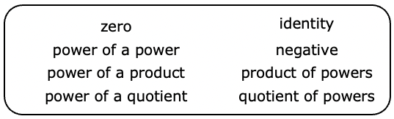
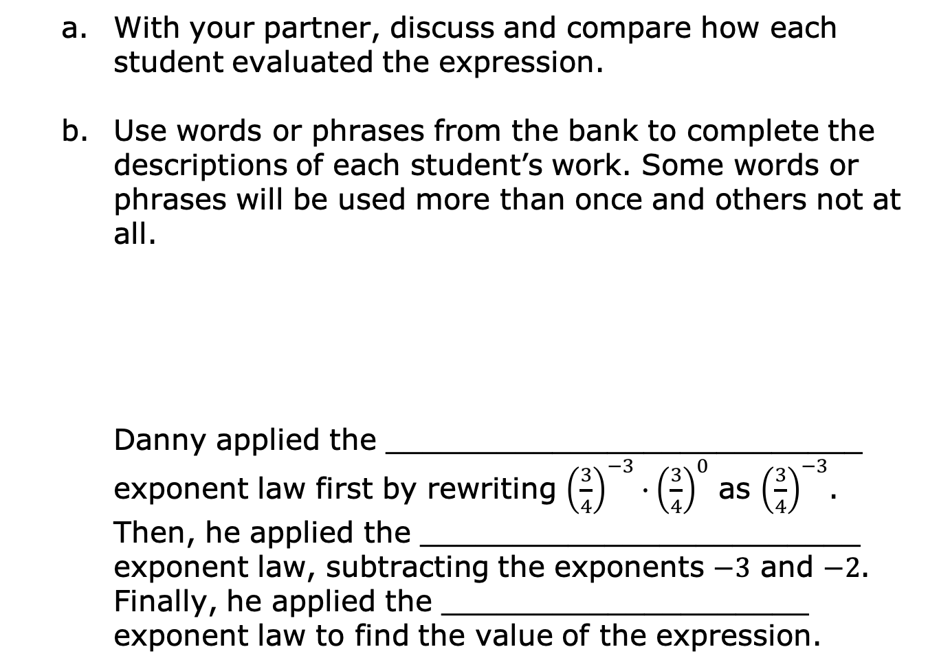
With your partner, discuss and compare how each student evaluated the expression.
Use words or phrases from the bank to complete the descriptions of each student’s work. Some words or phrases will be used more than once and others not at all.
Danny applied the __________________________ exponent law first by rewriting ${\left(\frac{3}{4}\right)}^{−3}∙{\left(\frac{3}{4}\right)}^{0}$ as ${\left(\frac{3}{4}\right)}^{−3}$. Then, he applied the ________________________ exponent law, subtracting the exponents $−3$ and $−2$. Finally, he applied the ____________________ exponent law to find the value of the expression.
volume 1, pg. 132

Slide 18
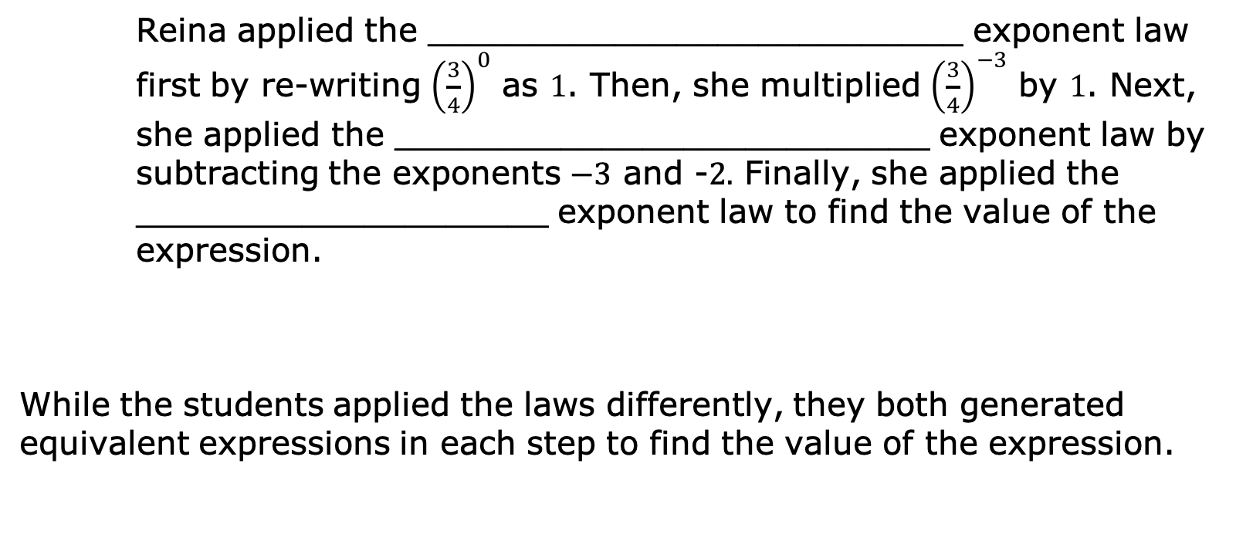
Reina applied the __________________________ exponent law first by re-writing ${\left(\frac{3}{4}\right)}^{0}$ as $1$. Then, she multiplied ${\left(\frac{3}{4}\right)}^{−3}$ by $1$. Next, she applied the __________________________ exponent law by subtracting the exponents $−3$ and -$2.$ Finally, she applied the ____________________ exponent law to find the value of the expression.
While the students applied the laws differently, they both generated equivalent expressions in each step to find the value of the expression.
volume 1, pg. 132

Slide 19

Collaboration
volume 1, pg. 133

Slide 20


3.6.5 Collaboration: Choose Your Own Adventure!
Consider the expression $\frac{{(2^{−1})}^{3} ∙{ \left(\frac{1}{2}\right)}^{−4}}{2 ∙ 2^{2}}$.
Discuss with your partner which exponent laws could be applied in the first step. Check off all that apply from the list.
Zero Exponent Identity Exponent Negative Exponent Power of a Power | Product of Powers Power of a Product Quotient of Powers Power of a Quotient
volume 1, pg. 133

Slide 21
Evaluate the expression beginning with a different first step than your partner.
Compare your work with your partner’s and come to a consensus about the value of the expression. Discuss the similarities and differences in your work.
volume 1, pg. 133

Slide 22
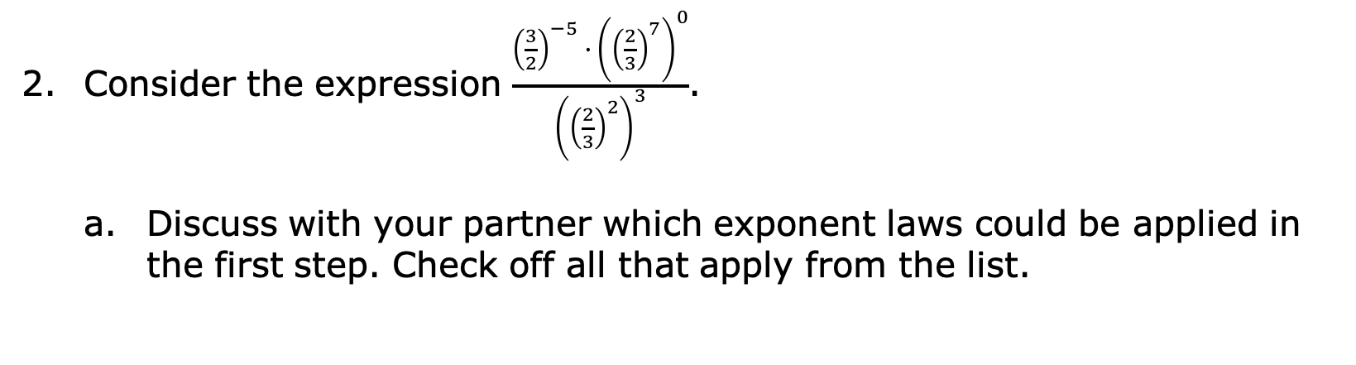
Consider the expression $\frac{{\left(\frac{3}{2}\right)}^{−5} ∙{ \left({\left(\frac{2}{3}\right)}^{7}\right)}^{0}}{{\left({\left(\frac{2}{3}\right)}^{2}\right)}^{3}}$.
Discuss with your partner which exponent laws could be applied in the first step. Check off all that apply from the list.
Zero Exponent Identity Exponent Negative Exponent Power of a Power | Product of Powers Power of a Product Quotient of Powers Power of a Quotient
volume 1, pg. 133

Slide 23
Evaluate the expression beginning with a different first step than your partner.
Compare your work with your partner’s and come to a consensus about the value of the expression. Discuss the similarities and differences in your work.
volume 1, pg. 133

Slide 24

Wrap-Up
volume 1, pg. 134

Slide 25
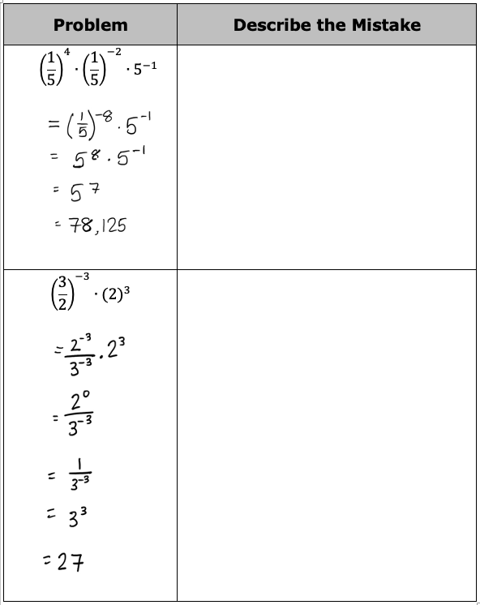
3.6.6 Wrap-Up: Error Analysis
Two students each evaluated an expression. Their work is shown in the table. Each student made a mistake. Circle the step where each student made an error and describe the mistake they made.
volume 1, pg. 134

